Slide 1
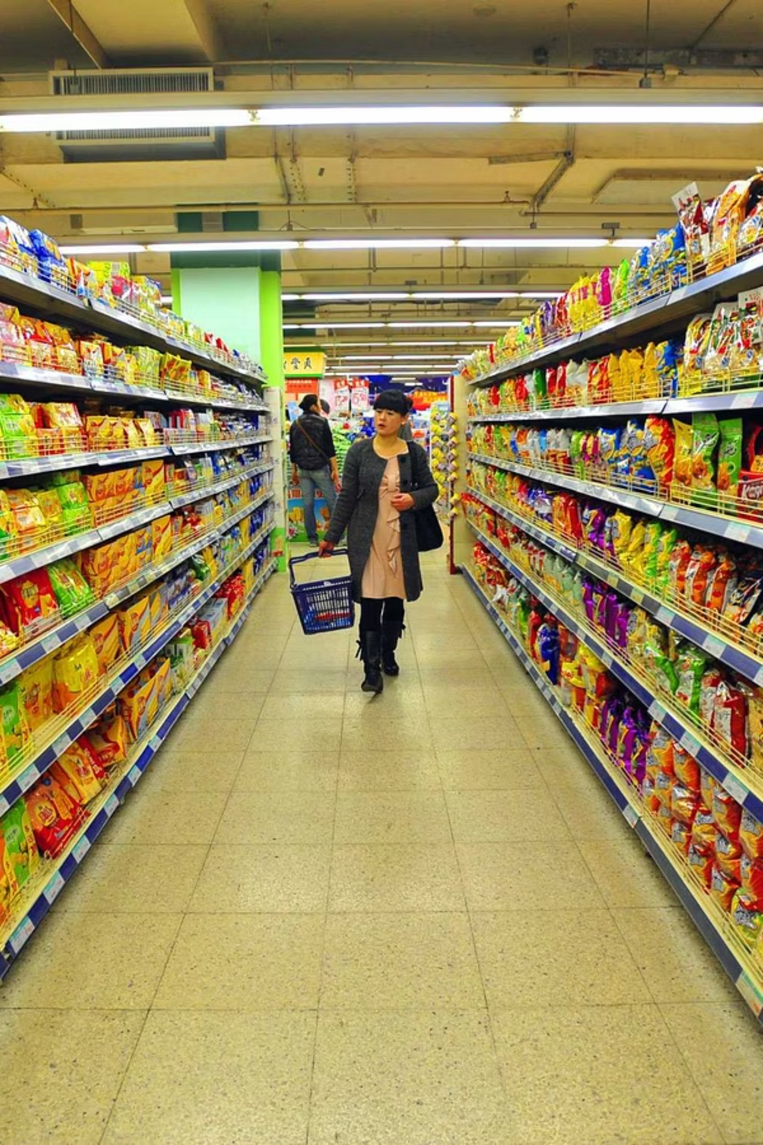

Executive Summary: Tamil Nadu Retail Operations (2015–2018)
Gross Revenue: ₹159.14 Cr | 10.63 Lakh Orders | 5,305 Customers | ₹19.73 Lakh Profit
by Akhil

Slide 2
Technical Stack
Data Visualization
Features Used
Data Cleaning
Microsoft Excel (Advanced)
Pivot Tables
Standardized regional naming conventions
Power Pivot
Multi-axis Line Charts
Date formatting for year-over-year comparison
Dynamic Slicers

Slide 3
Key Recommendations
Discount Optimization
Inventory Planning
Reduce average discount of 22.6% in high-demand categories to improve profit margins.
Intensify supply chain efforts in Q3 and Q4 to meet September-November demand surge.
Customer Retention
Market Expansion
Implement Loyalty Program to lock in recurring revenue (5,305 customers, high purchase frequency).
Launch targeted campaigns in underperforming regions like Dharmapuri and Viluppuram.

Slide 4

Regional & Category Analysis
Top Performing Hubs
Category Leaders
Underperforming Markets
Vellore
Snacks
Dharmapuri
Kanyakumari
Eggs, Meat & Fish
Viluppuram
Tirunelveli
This analysis highlights the opportunity for targeted regional marketing.

Slide 5

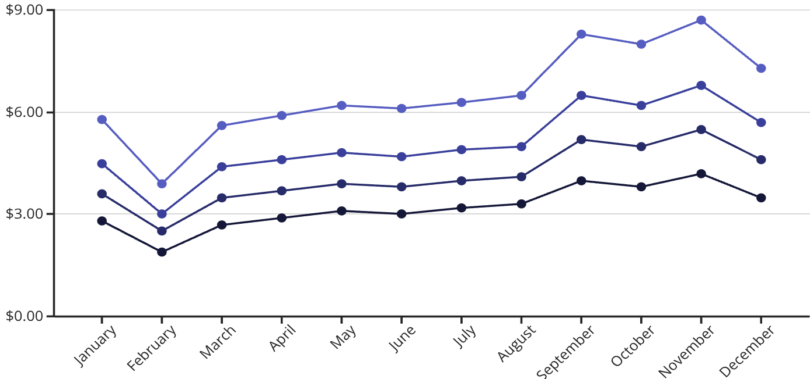
Strategic Sales Trends
2015 Sales (₹ Cr)
2016 Sales (₹ Cr)
2017 Sales (₹ Cr)
2018 Sales (₹ Cr)
The sales data for Tamil Nadu retail operations highlights several important trends:
Growth Trajectory: The chart demonstrates a significant upward trend in sales volume from 2015 to 2018, with 2018 showing the highest peak in overall revenue.
Quarterly Peaks: We consistently observe peak sales in September and November across all years, aligning with traditional festive and harvest seasons in the region.
Operational Lows: Conversely, February consistently remains the lowest performing month across all four years, indicating a recurring dip in consumer spending during this period.
Insight: This pattern indicates a strong cyclical nature in consumer spending within Tamil Nadu, requiring strategic planning to capitalize on peak seasons and mitigate losses during low periods.

Slide 6
Performance Overview
Gross Revenue
Transaction Volume
Market Reach
₹159,14,24,553 (Consolidated)
10.63 Lakh total orders
5,305 unique customers
Profitability
Average Discount Rate
₹19.73 Lakh total profit
22.6%

Slide 8




Action Plan & Next Steps
Immediate Actions (0-3 Months)
Medium-Term Initiatives (3-6 Months)
Optimize discounts in high-demand categories.
Implement a customer loyalty program.
Launch targeted campaigns in Dharmapuri & Viluppuram.
Refine inventory planning for Q3/Q4 demand.
Long-Term Strategy (6-12 Months)
Success Metrics & KPIs
Explore new market expansion opportunities.
Increase in profit margins & customer retention.
Develop data-driven seasonal sales strategies.
Revenue growth in underperforming regions.
Overall sales growth, especially in low months.

Slide 9
Market Insights & Opportunities
Understanding the dynamics of the Tamil Nadu retail market reveals clear pathways for strategic growth and enhanced profitability.
Customer Loyalty Focus
Optimize Seasonal Peaks
Cultivate the existing 5,305 high-frequency customers through targeted loyalty programs to secure recurring revenue streams and increase lifetime value.
Capitalize on strong demand in September-November with proactive inventory management and marketing. Address the consistent sales dip in February with strategic promotions.
Target Underperforming Regions
Category Expansion Potential
Launch dedicated market campaigns and enhance presence in Dharmapuri and Viluppuram to unlock significant untapped growth potential and market share.
Explore expanding into complementary high-demand categories such as packaged foods, dairy products, or beverages, leveraging the success of snacks and fresh produce.

